Slide 1

Media Board Budget Presentation

Slide 2


Who are we?

Slide 3
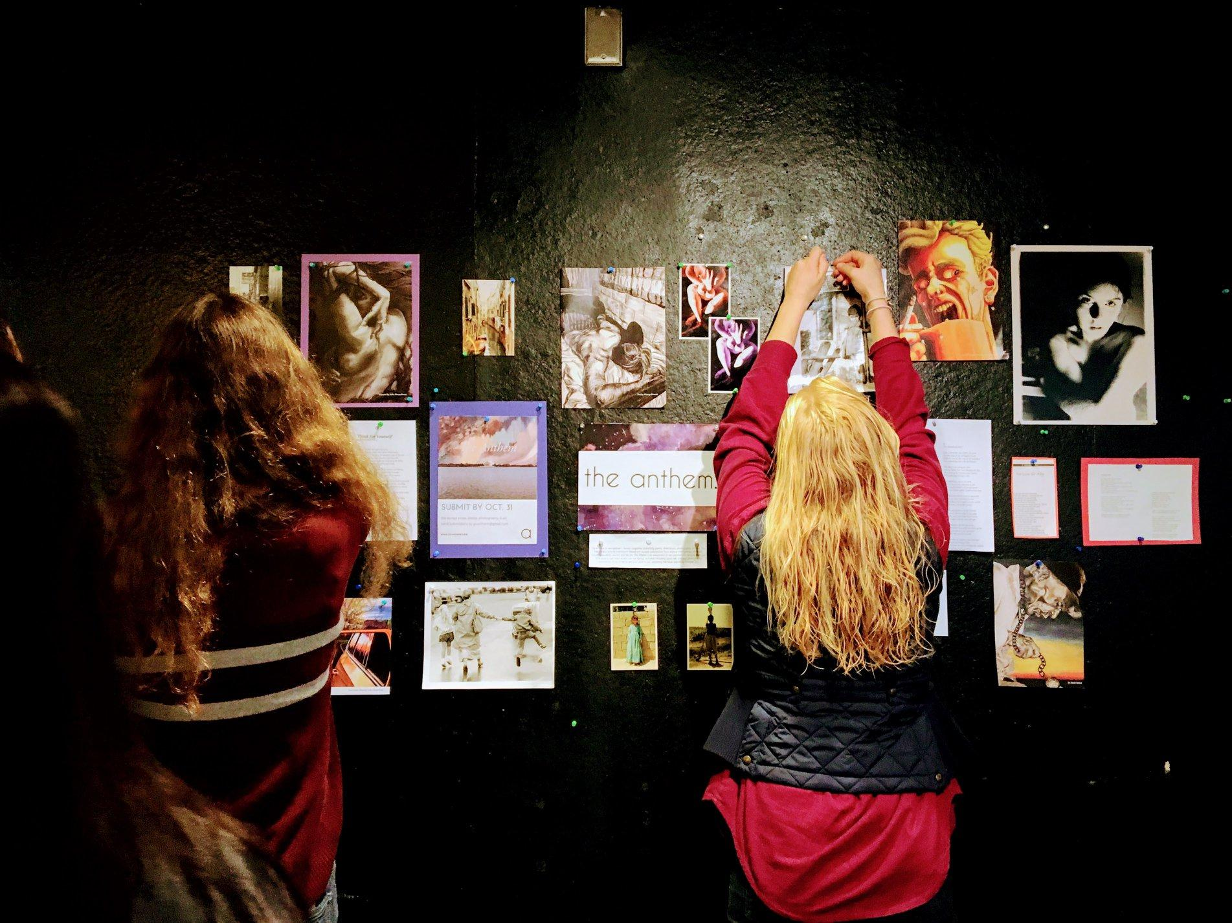
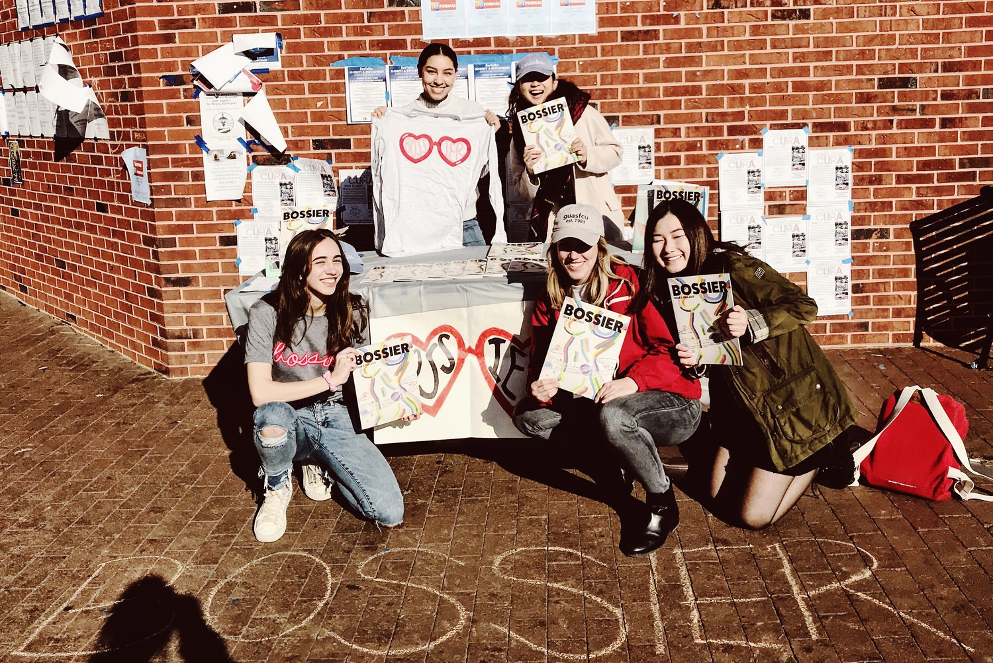
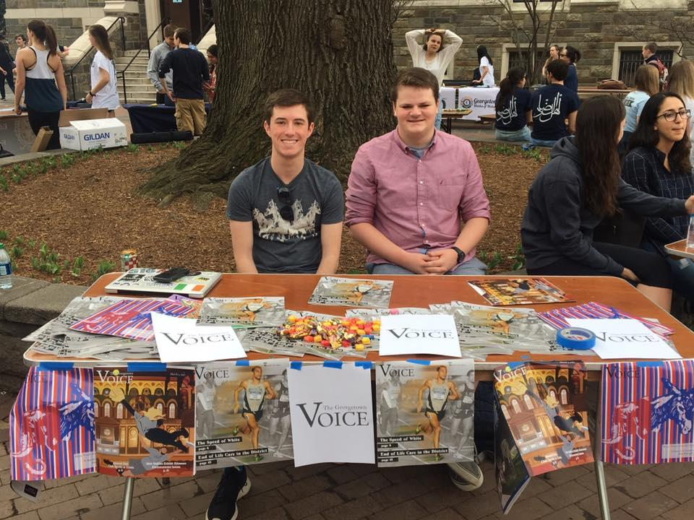
Media Board: Who We Are
14 organizations that produce journalistic, academic, creative, and social content
Common goals:
Providing platforms for student voices
Fostering creativity
Distributing knowledge and art

Slide 4
Measuring our engagement

Slide 5
Part 1: Exposure for Georgetown Students

Slide 6
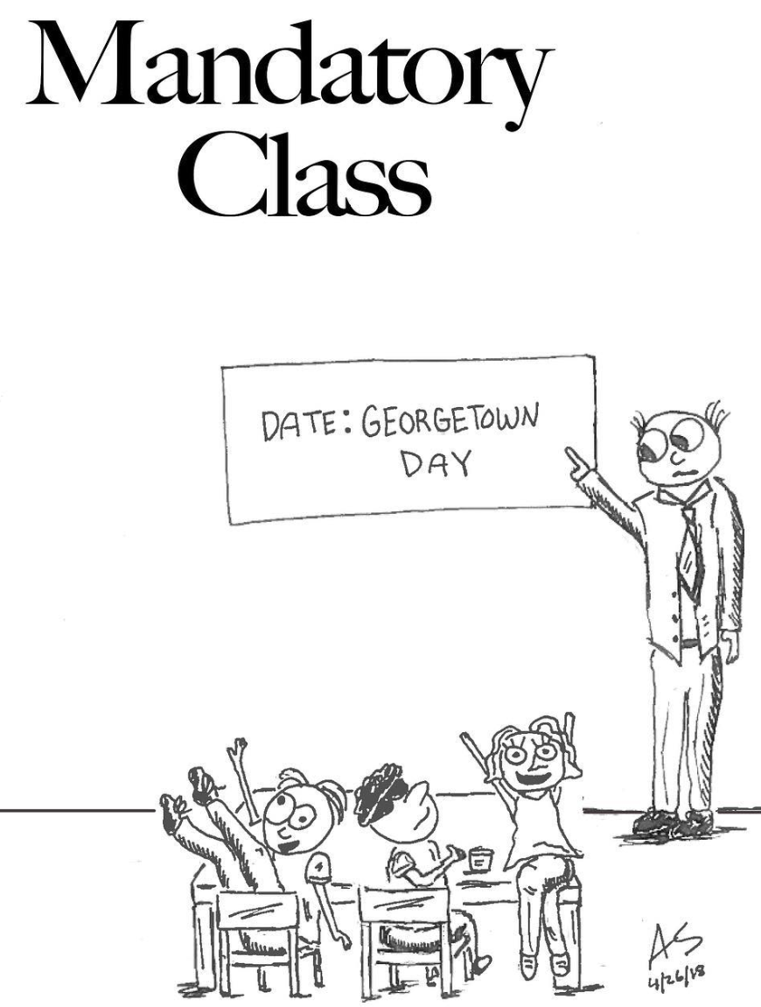
Diverse Platforms to Pursue Interests
The Hoya and The Voice
Platform that provides students with exposure to journalism to discuss politics at Georgetown and the world.
The Caravel
International affairs news source covering the latest information on gender, science, tech, and business in underreported regions of the world
WGTB
Opportunity for students to break into the music industry and learn valuable skills such as music programming and marketing

Slide 7
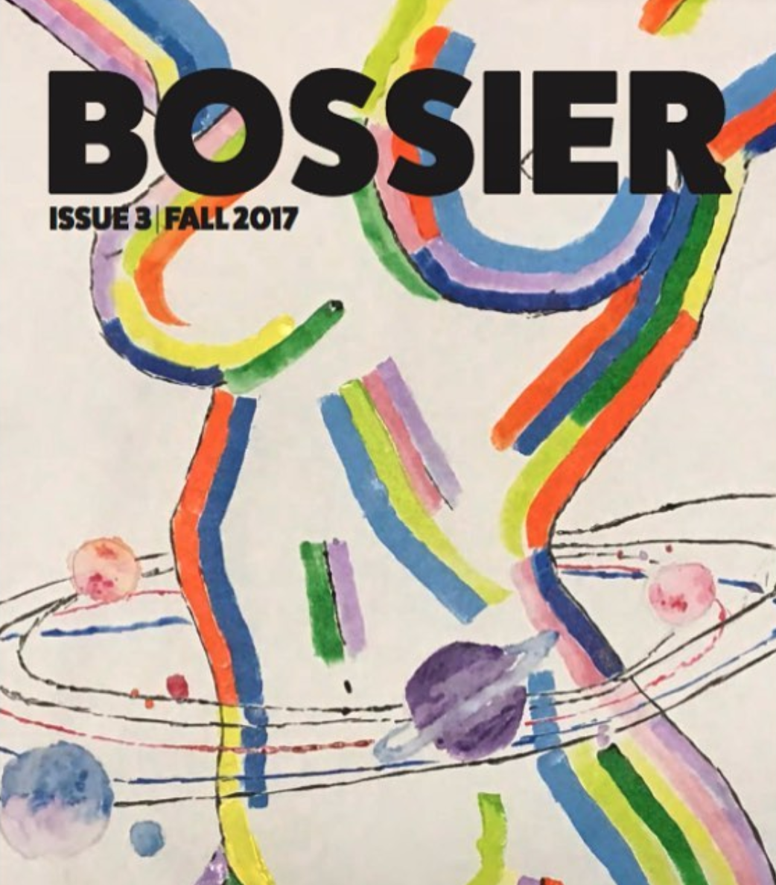
Diverse Platforms to Pursue Interests
The Anthem
Literary and arts publication showcasing the creative work of Georgetown students, faculty, and alumni
Bossier Magazine
Publication devoted to promoting intersectional feminism and publishing work by Georgetown students
Utraque Unum
Outlet provided to students to discuss and write about scholarly topics they may be interested in

Slide 8
Skills Learned by Students
Journalism
Ethics
Reporting
Writing
Photography/Filmmaking
Creative Writing
Music Programming
Broadcasting
Marketing
Selling Advertisements
Budgeting for fiscal years
Students have gone on to work and intern at major organizations because of the skills they have learnt here:
POLITICO
The Washington Post
The New York Times
9:30 Club
NBC
NPR

Slide 9
Importance of Print
Archival value in print edition
Alumni regularly reach out in hopes to see current and past issues featuring their own work
Important factor in student engagement
Without print issues of many of our publications, many students would not know the impact each print organization has on the campus
Staff development
Witnessing your output in the hands of others is a great way for students to improve on their deliverable product
Tangible product develops great brand image

Slide 10
Part 2: Engagement with the Community

Slide 11






Tracking impact across 14 organizations
+1,630,688
annual views
+142,150
issues
+695
members
+2,527
followers
+20,945
followers
+12,751
followers
Historic deficiency and new efforts:
(1) Manually tracking print circulation
But: high margin of error
(2) Engagement and viewership analysis
But: uneven distribution of viewership and engagement

Slide 12
Financial Challenges & Budget Concerns

Slide 13
Sustainability
Technology and infrastructure
Office servers
Adobe subscriptions (unanimous issue across all media orgs)
Equipment (WGTB, GUTV, The Voice)
Website costs

Slide 14
Costs of Participation
“Last year, our decade-old server in our office failed spontaneously, leading us to run our entire paper of a set of 12 flash drives for an entire semester. An evaluation of our technology by UIS found our infrastructure woefully out of date, to the point of being outright dangerous.”
Maya Gandhi (Editor in Chief of The Hoya)
“For the past three years, the Treasurer has paid for the website and the Marketing Director has paid the printing costs of flyers. The website and flyers are the main ways we interact with the community and garner submissions for the magazine. Without adequate funding for these basic means of communication, our publication will not be sustainable.”
Courtney Lee (Editor in Chief of The Anthem)
“Due to lack of funds, we were not able to host a spring event last year. The rising printing cost also took away funds for group bonding activities and adversely impacted our ability to retain our writers and executive members.”
The Caravel

Slide 15
Print vs. Online Production
Though moving towards online heavy production might seem easy, the capital restraints make the transition much more difficult:
Professional websites and online platforms
Limited to low cost designers or volunteer work from students
Less print volume
Losing community engagement through loss of tangible product
Losing advertising revenue (The Hoya, The Caravel, and the Voice)
Reducing non-operational expenses
Forcing members to pay out of pocket for membership development at a school where they pay so much money already

Slide 16
Expansion and Inclusion
New clubs (2 NCD)
Outreach, marketing, and shipping costs
Socioeconomic diversity within media organizations
Software subscriptions $$$
Traveling expenses $$$
Student time $$$
Basic amenities, like ink and computers, paid by leadership
Notes:
Because we only have so much money, it all ends up going to printing/website costs. Leaves little room for other things that make our orgs sustainable.
Adobe is absolutely necessary for layout and design. But leadership positions for layout and design end up going to the students who are able to afford the subscription. Also, very difficult to run a meeting in offices that don’t have computers with Adobe. So we can’t have board meetings and layout our magazines/newspapers at the same time.
Say the Voice or the Hoya wants to send a student to do a concert review. They can pay for the ticket but maybe not the uber.
Journalism and magazine are full time jobs. Without a solid infrastructure we cannot run efficiently, and the added time is an unnecessary burden on student schedules.

Slide 17
Why We Matter

Slide 18
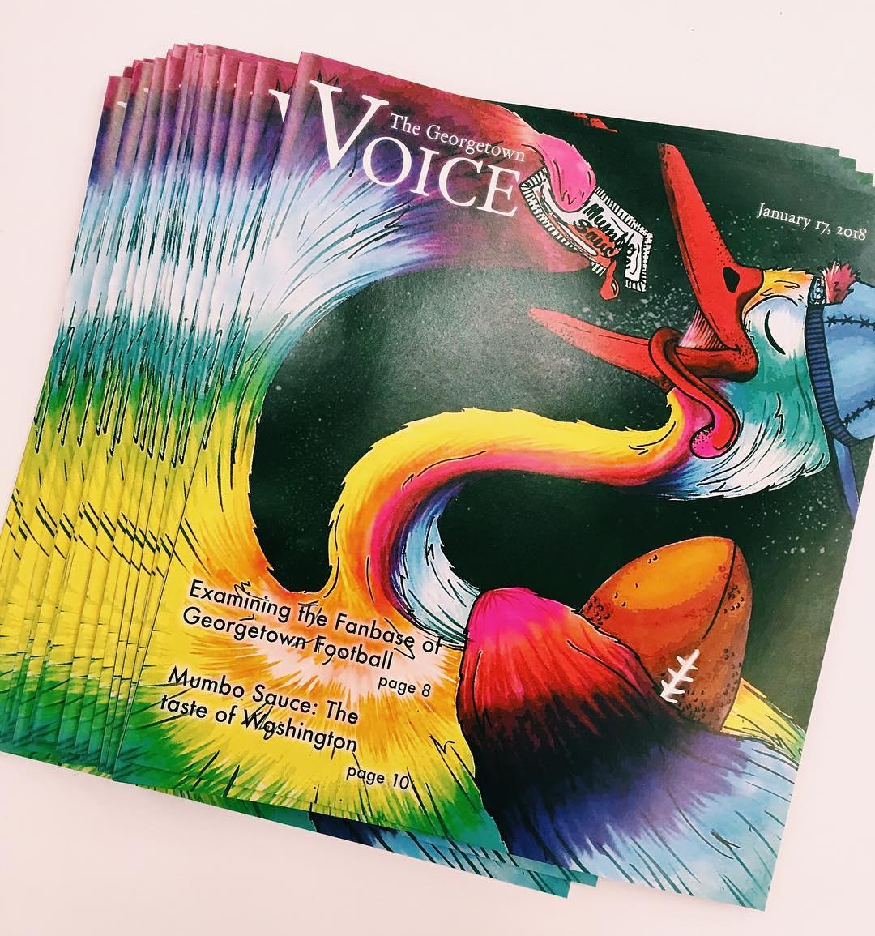

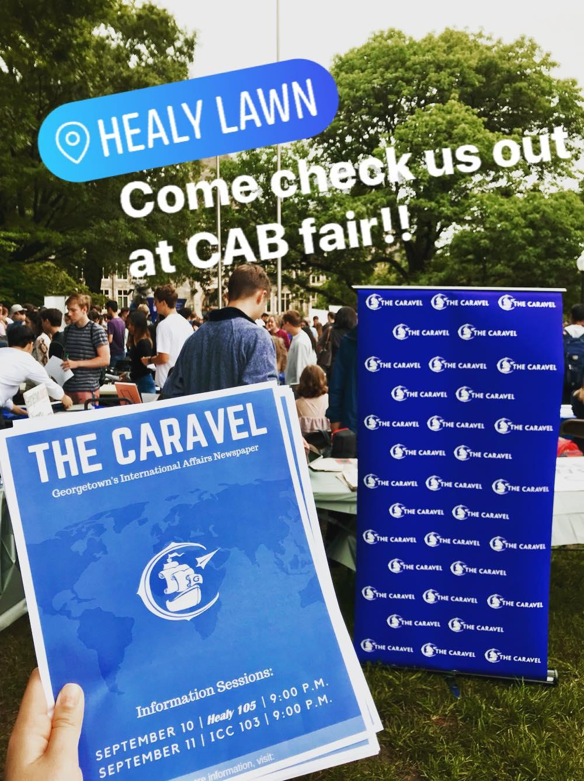
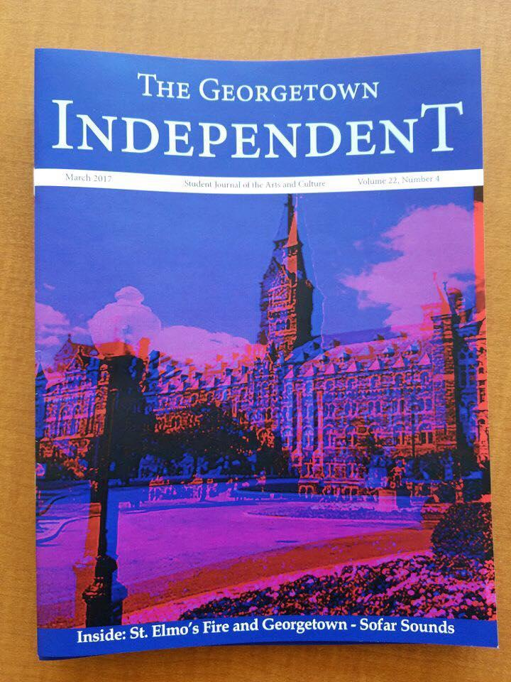

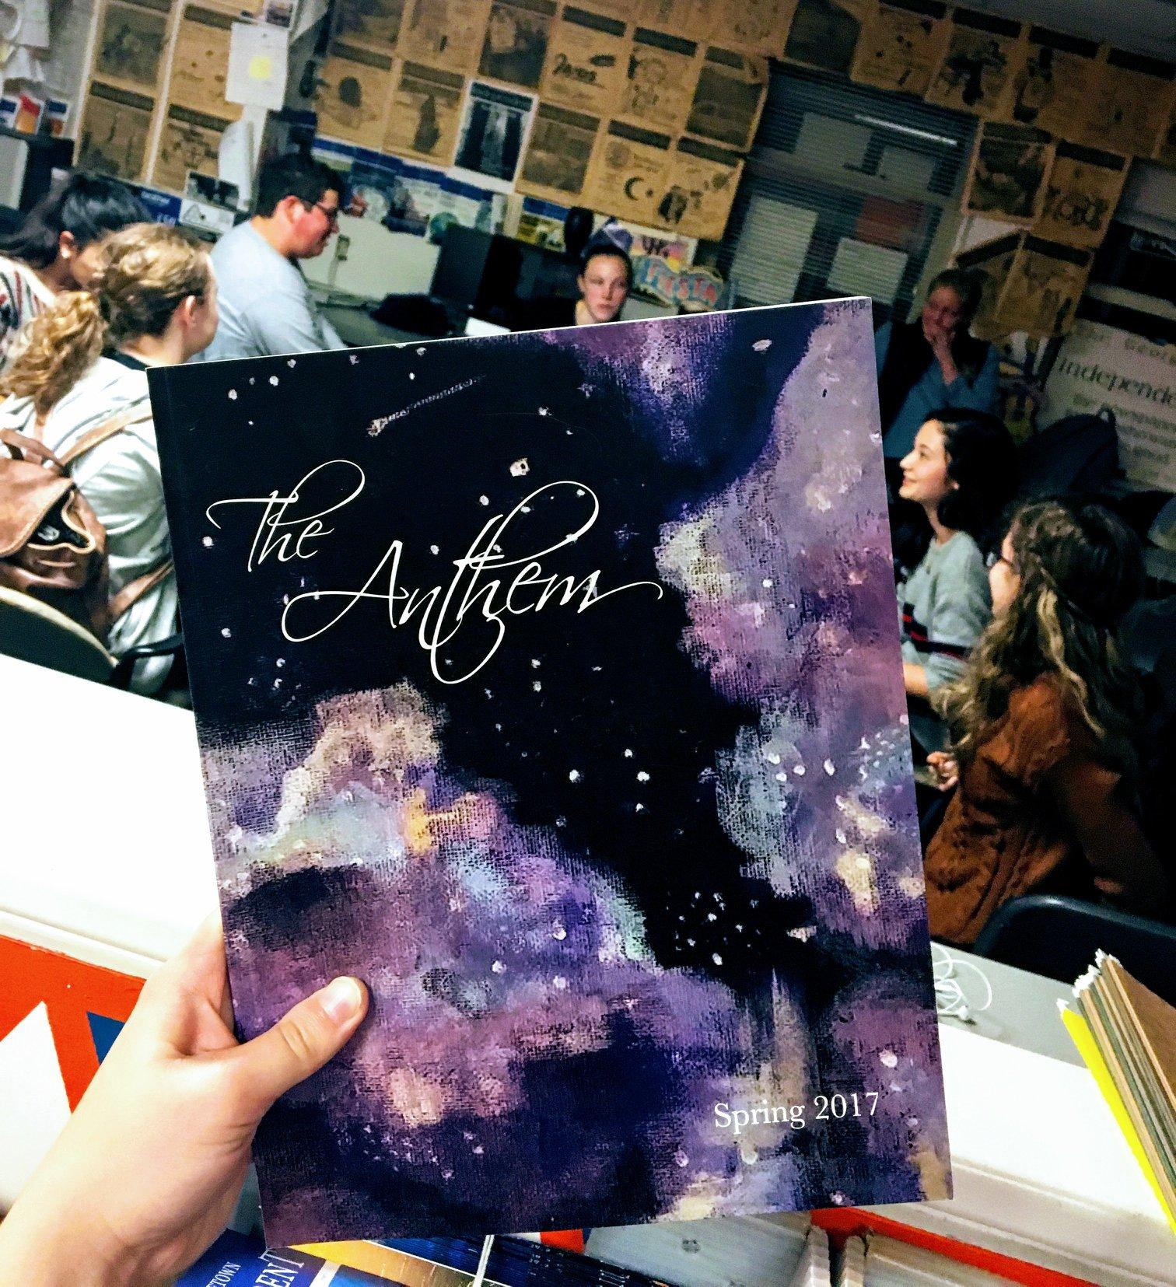

Notes:
The face of gtown, our content is an expression of who we are
Creativity outside the classroom
Lasting, tangible projects
A community beyond graduation

